Slide 1
Cryptocurrencies
Prediction Analysis & Buying Actions
By Michael Cuffaro
Disclaimer: I am not a financial institution nor do I represent one. All that I am providing is education material: Do not take this information as professional investment advice.

Slide 2
Introduction
What Will This Project Deliver?
Insight into the cryptocurrency market by:
Investigating potential correlations between cryptocurrencies
Using Machine Learning to make prediction models
Using models to develop a trading strategy
Disclaimer: I am not a financial institution nor do I represent one. All that I am providing is education material: Do not take this information as professional investment advice.

Slide 3
Introduction ^{(Cont’d)}
Which Cryptocurrencies Will Be Included?
Bitcoin, Ethereum, Litecoin, and Zcash
How Will Analysis Be Performed?
Analysis will be performed with Python
Python packages utilized: NumPy, Pandas, Seaborn, Matplotlib, Sklearn
Where to Retrieve Project Code?
Github:
Disclaimer: I am not a financial institution nor do I represent one. All that I am providing is education material: Do not take this information as professional investment advice.

Slide 4
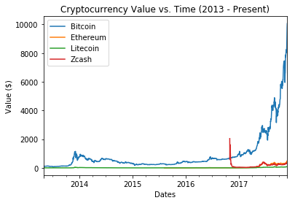
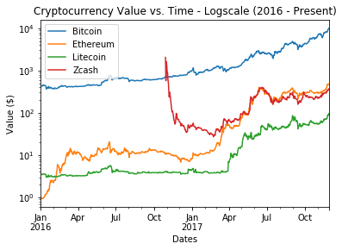
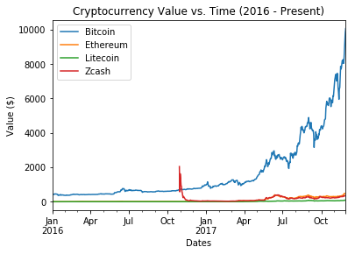
Exploring Value over Time
Same Scale Comparison
Data Source: CoinMarketCap
Date Range Analyzed: 4/28/2013 - 11/28/2017
Disclaimer: I am not a financial institution nor do I represent one. All that I am providing is education material: Do not take this information as professional investment advice.

Slide 5
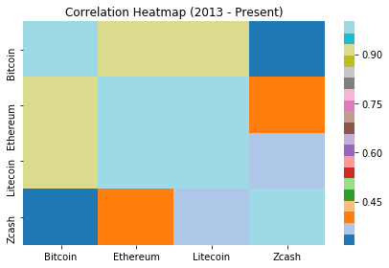
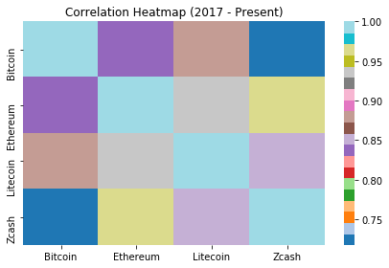
Investigating Correlation
1.0
.91
.91
.31
2013 - Present
Average Pearson Correlation is .78
1.0
.84
.89
.72
2017 - Present
Average Pearson Correlation is .86
Disclaimer: I am not a financial institution nor do I represent one. All that I am providing is education material: Do not take this information as professional investment advice.

Slide 6
Modelling Background
Best Overall Model
Determined by Lowest Root Mean Square Error (RMSE)
What is RMSE?
RMSE tells us on average how far our predictions are from true cryptocurrency values
Look Back Period
Number of days used to make a single day prediction
Models Being Investigated
Linear Regression
Ridge Regression
Disclaimer: I am not a financial institution nor do I represent one. All that I am providing is education material: Do not take this information as professional investment advice.

Slide 7
Model Selection – Linear Regression
RMSE for Each Cryptocurrency Model
Look Back Period (Days) | Bitcoin ($) | Ethereum ($) | Litecoin ($) | Zcash ($) | RMSE’s ($)
1 | 136.6 | 15.7 | 2.49 | 42.3 | 197.16
2 | 148.1 | 17.2 | 2.8 | 48.1 | 216.18
3 | 137.8 | 16.8 | 3.07 | 17.7 | 175.33
4 | 163.6 | 15 | 2.96 | 20.7 | 202.2
5 | 152.7 | 20.6 | 2.92 | 19 | 195.25
6 | 150.7 | 16.8 | 2.86 | 14.7 | 185.02
7 | 143.5 | 25.3 | 1.98 | 24.1 | 194.78
8 | 193.5 | 21.7 | 4.17 | 22.4 | 241.77
9 | 121.2 | 26.9 | 2.97 | 19.1 | 170.22
10 | 170.7 | 19.4 | 3.75 | 22.9 | 216.73
20 | 203.2 | 40.8 | 3.78 | 61.3 | 309.05
30 | 186.2 | 16.6 | 3.78 | 61.3 | 267.84
Disclaimer: I am not a financial institution nor do I represent one. All that I am providing is education material: Do not take this information as professional investment advice.

Slide 8
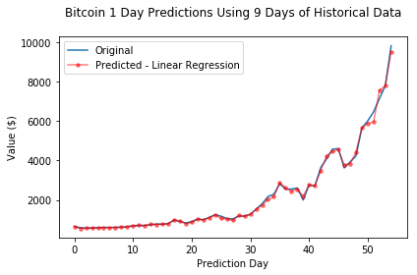
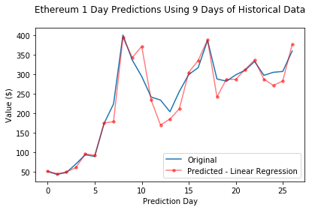
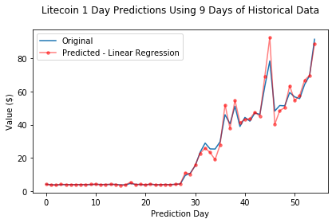
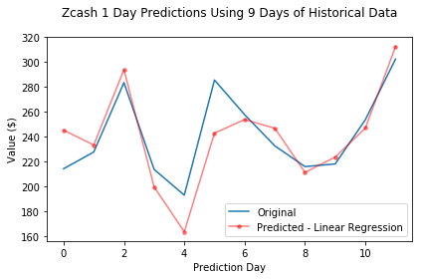
Model Predictions – Linear Regression
RMSE = $121
RMSE = $27
RMSE = $3
RMSE = $19
Disclaimer: I am not a financial institution nor do I represent one. All that I am providing is education material: Do not take this information as professional investment advice.

Slide 9
Model Selection – Ridge Regression
RMSE for Each Cryptocurrency Model
Look Back Period (Days) | Bitcoin ($) | Ethereum ($) | Litecoin ($) | Zcash ($) | RMSE’s ($)
1 | 136.69 | 15.69 | 2.49 | 42.34 | 197.21
2 | 148.08 | 15.19 | 2.8 | 47.94 | 214.01
3 | 137.82 | 16.75 | 2.11 | 17.72 | 174.4
4 | 163.5 | 14.69 | 2.96 | 20.7 | 201.85
5 | 153.61 | 24.9 | 2.92 | 18.14 | 199.57
6 | 152.48 | 16.6 | 2.31 | 14.62 | 186.01
7 | 146.59 | 25.74 | 2.08 | 23.5 | 197.91
8 | 197.53 | 30.3 | 4.33 | 22.41 | 254.57
9 | 120.29 | 19.84 | 2.07 | 18.11 | 160.31
10 | 172.08 | 19.84 | 3.74 | 19.66 | 215.32
20 | 225.04 | 30.59 | 4.08 | 25.95 | 285.65
30 | 150.16 | 19.49 | 2.73 | 31.87 | 204.25
Disclaimer: I am not a financial institution nor do I represent one. All that I am providing is education material: Do not take this information as professional investment advice.

Slide 10
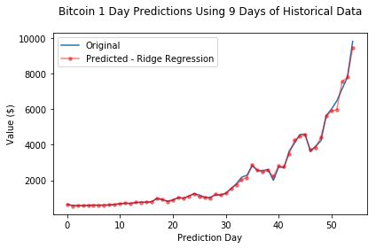
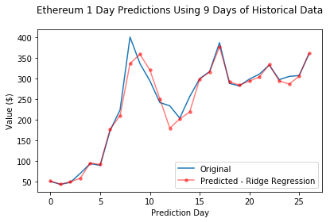
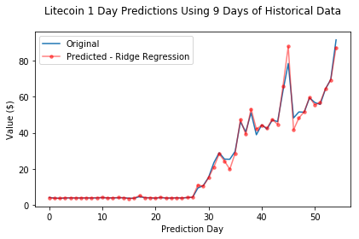
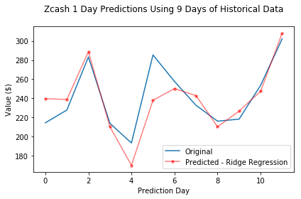
Model Predictions – Ridge Regression
RMSE = $120
RMSE = $20
RMSE = $2
RMSE = $18
Disclaimer: I am not a financial institution nor do I represent one. All that I am providing is education material: Do not take this information as professional investment advice.

Slide 11
Trading Strategy Based on Models
Trading Strategy Assumptions
Long-term investing
Actions will encompass a “Buy” or “Hold”
The difference in price over consecutive days will be used to determine trading action
Trading Action Summary
Comparison of Consecutive Days | Action
Negative (Price Decreasing) | Buy
Positive (Price Increasing) | Hold
Disclaimer: I am not a financial institution nor do I represent one. All that I am providing is education material: Do not take this information as professional investment advice.

Slide 12
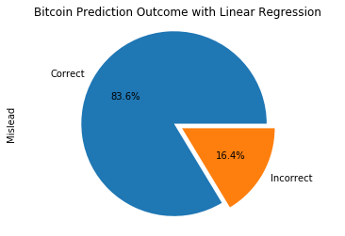
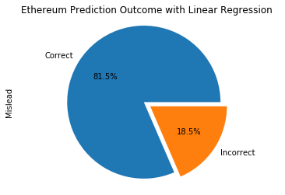
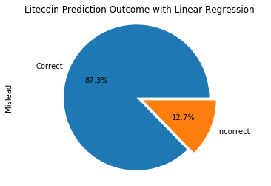

Trading Strategy Outcomes – Linear Regression
Disclaimer: I am not a financial institution nor do I represent one. All that I am providing is education material: Do not take this information as professional investment advice.
Notes:
Actions are compose of a “buy” or “sell”

Slide 13
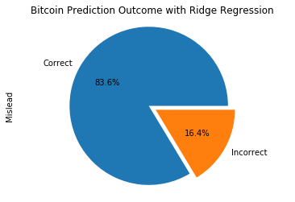
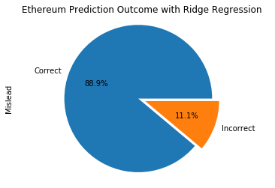


Trading Strategy Outcomes – Ridge Regression
Disclaimer: I am not a financial institution nor do I represent one. All that I am providing is education material: Do not take this information as professional investment advice.
Notes:
Actions are compose of a “buy” or “sell”

Slide 14
Summary
Strong positive correlation (.86) is present between Bitcoin, Litecoin, Ethereum, and Zcash
Optimal model produced with Ridge Regression using 9 days of Historical data
Trading strategy offers at least 80% accuracy across all four cryptocurrencies
Optimal Prediction Model Summary
Cryptocurrency | Avg. Price Variance
Bitcoin | $120
Ethereum | $20
Litecoin | $2
Zcash | $18
Disclaimer: I am not a financial institution nor do I represent one. All that I am providing is education material: Do not take this information as professional investment advice.

